Slide 1
P&G Global Innovation Challenge
Tackling
The Biggest
Challenges
In FMCG Industry
Predicting Stock out Probabilities of FMCG using Retail Analytics & AI
Team sumit5555_5dc4 - Sumit Keshav, Pawan Subhash
IIT (BHU) Varanasi

Slide 2
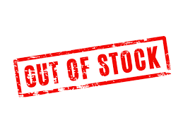

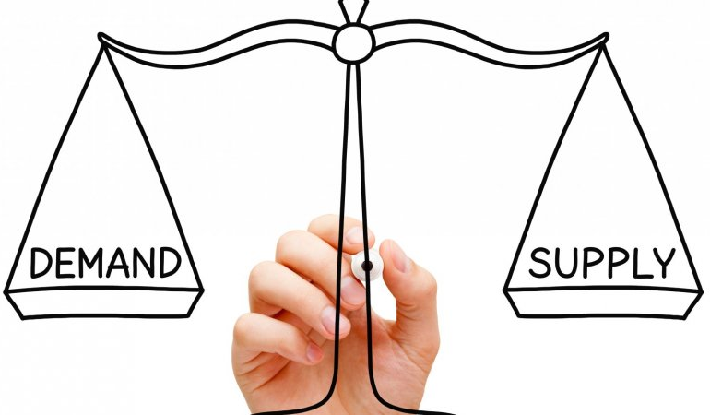

Slide 3
Data Insights
Fig: No. of Fast-Moving Items and corresponding Lost Sales

Slide 4
Operational Losses due to OOS
Brand Owner / Manufacturer
Retailer / Distributor
OOS leads to irregular ordering thus impacting Brand/Trade relationship.
Improper Ordering by Trade leads to reduced turns and thus impacting overall Return on Investment(ROI).
OOS leads to improper demand planning /sensing thus impacting Production Scheduling(frequent changes and inefficient production runs).
Stress the relationship between Distributor and retailer and additional costs for query resolution and grievance handling(arising out of confusion created by OOS)
Leads to Hoarding mentality across distributors / retailers thus further impacting Demand Vs Dispatch relationship.
OOS lowers the expected impact of Trade Promotions and Marketing Activities.

Slide 5
Strategic Losses due to OOS
Brand Owner / Manufacturer
Retailer / Distributor
Direct Loss of Brand loyalty and Brand equity.
Trade Loyalty loss for Distributor (with Retailer) and store loyalty loss for retailer (with consumer)
Retailer OOS results into Customer dissatisfaction and sometimes loss of Customer (store switching)
OOS encourages Trial of Competition / New Brands / Counterfeit Products
Retailer may decide to stop stockingthe product or push competiotion / counterfeit products.
Demotivation for the frontline Sales team.

Slide 6



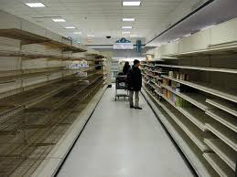
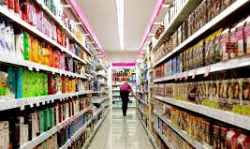
An Attempt To Lower OOS
P&G’s research established that 47 percent of OOS events were caused by store forecasting. As this is the biggest chunk of root causes, we invested a lot of thought into better understanding this problem. Overall, the goal here is to understand the degree that greater the forecasting accuracy drives lower levels of OOS.
We know that previous sales do not equal the actual demand, if lost sales have occurred. In this case demand equals sales plus lost sales due to OOS. Unfortunately, in brick and mortar retail, lost sales are unobserved. Therefore, the inherent problem of estimating demand with unobserved sales is that all models are imperfect because as true demand is unknown it is difficult to validate how close to demand the proposed model has come.
To solve this we need the data of complete time-series of OOS of each product in its store. Such data can be generated manually every day for a period of time or image processing using low MP cameras can be done in actual implementation in a cost effective manner to get continuous data. Robust ML ensembles can be made used on such data to solve our problem.

Slide 7
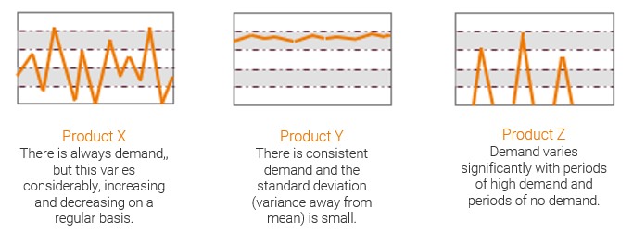
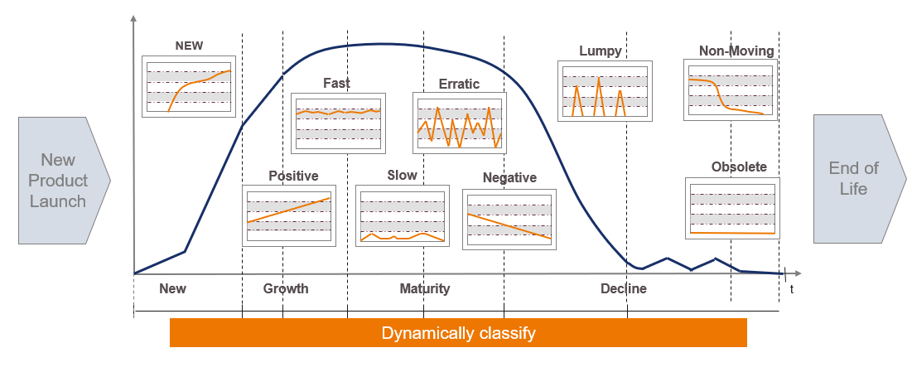
Changing Demand Types in Product Life Cycle
Data Fragmentation - Division of products based on demand type
latest deep learning techniques for forecasting using LightGBM and Wavenet Networks
Build the features for our Stockout binary classification models
OOS Probability Calculation

Slide 8
Case A : Strategic and Operational losses and left unobserved and routine Supply Chain logistics are followed. Such a big opportunity for a drastic breakthrough in FMCG Industry is left unutilised.
Case B : Recognized such a big scope for improvement in FMCG sector. Identified the challenges to overcome and worked on them using the rapidly growing technological innovations.

Slide 9
Model Architecture
Demand forecasting from POS using LSTMs
Data Generation
Down Sampling for getting maximum OOS Classes
Predictive Modeling
ML Models
Imbalanced Class Tensorflow models
Predictions
OOS Probabilities
Actionable Insights
Optimum Production Count
Reorder Point

Slide 10
MODEL EVALUATION : THE METRIC
Most of the products are in stock, the distribution is skewed
F1 Score and Area Under ROC Curve are better metrics

Slide 11
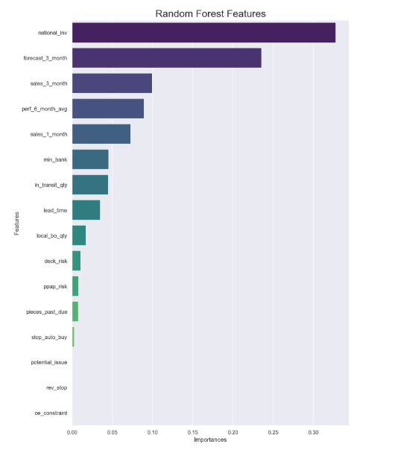
Actionable Insights Generation
Output missing features sorted in order of feature importance
Feature importance calculated using the model heuristics

Slide 12
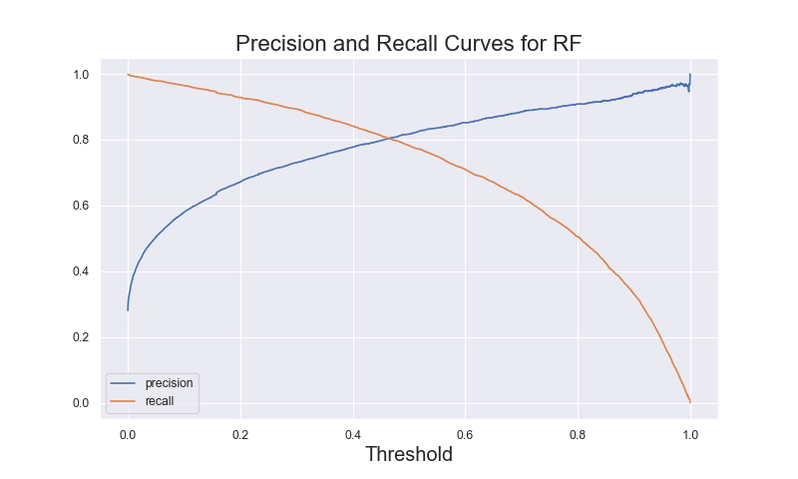
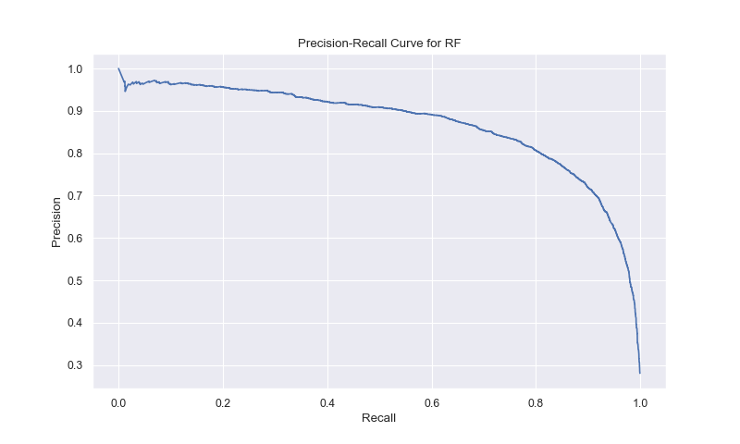
Precision Recall Curves

Slide 13
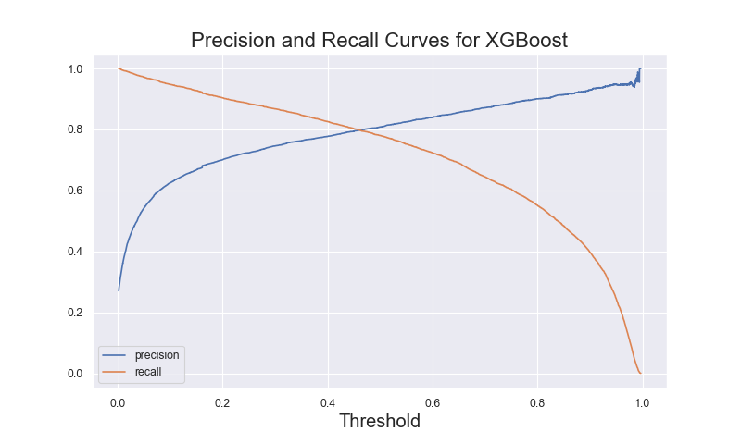
Precision Recall Curves

Slide 14
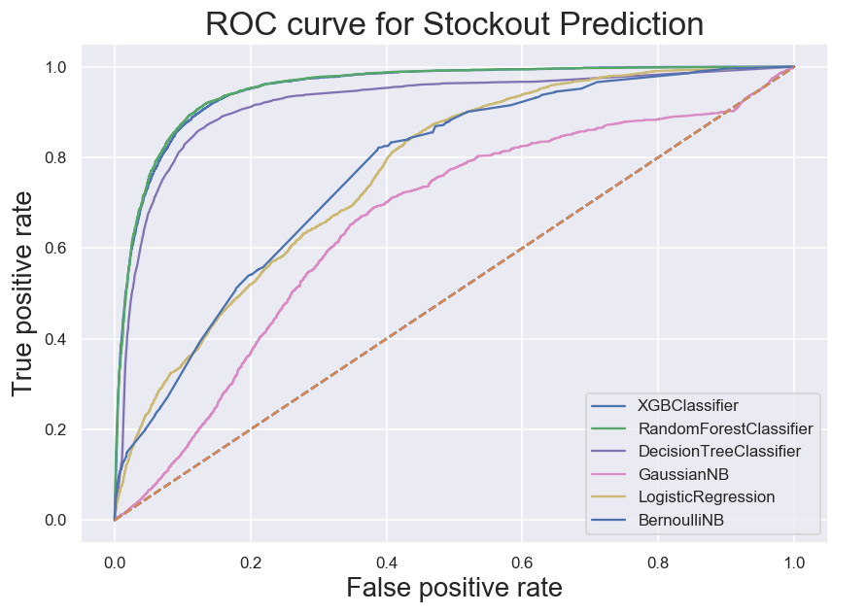
ROC & AUC Scores for various Models
XGBClassifier ROC AUC score : 0.952092
RandomForestClassifier ROC AUC score : 0.953430
DecisionTreeClassifier ROC AUC score : 0.919720
GaussianNB ROC AUC score : 0.654640
LogisticRegression ROC AUC score : 0.690219
BernoulliNB ROC AUC score : 0.768038

Slide 15
Why Sensitivity?
Since we are interested in the number of OOS predicted to that which are actually OOS. Detecting this tells about the recall and robustness of the model. Gives more value to the kind of problem we are tackling.
Why Specificity?
Classifying Instock phenomenan as OOS can be tolerated upto some extent, since recommending OOS without any stockout in reality will result more piling up of inventory. However This causes storage expenses. Hence Specificity metrics is also a concern while modeling.

Slide 16
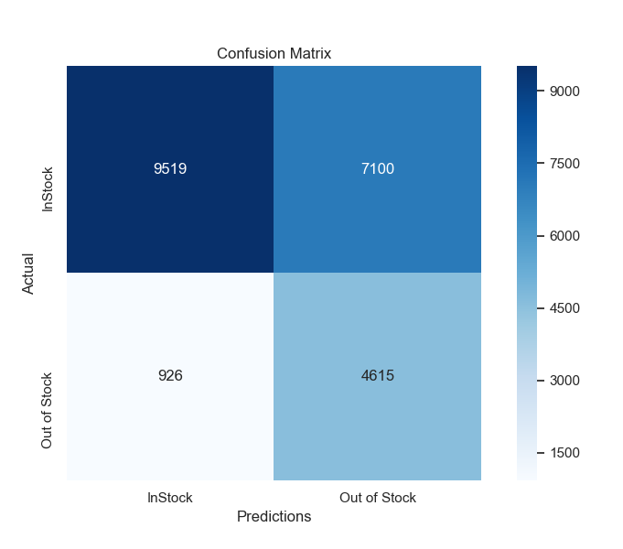
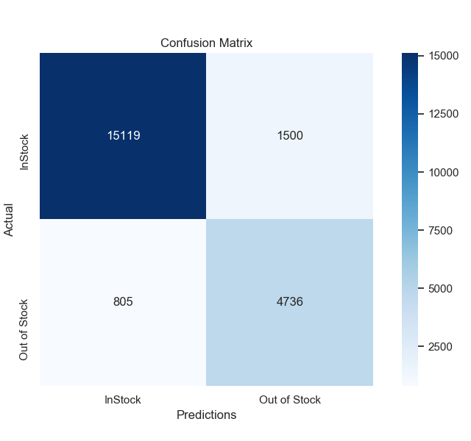



Improving Sensitivity & Specificity
Logistic Regression
XGBoost
Random Forest
Sensitivity : 0.393
Specificity : 0.570
Sensitivity : 0.855
Specificity : 0.909
Sensitivity : 0.846
Specificity : 0.917
Sensitivity =
$$\frac{\text{True} \text{P}\text{ositive}}{\text{True} \text{Positive}\text{ + }\text{False} \text{Negative} }$$
Specificity =
$$\frac{\text{True} \text{Negative}}{\text{False} \text{Positive}\text{ + }\text{True} \text{Negative} }$$

Slide 17
SWOT Analysis
Strengths
Weaknesses
OOS duration is minimised.
Actionable insights decided connecting all the relevant factors
Support from the retailer is required
Stock Management becomes easy.
Data generation is difficult.
Strategic Value-Adding Promotions.
Can’t accurately estimate the lost sales during OOS.
Overstock is prevented
Opportunities
Threats
AI in FMCG operations
Potential to set new trends in Retail .
Sudden changes like Covid-19 make the model crash.
Other innovations may develop which may be more efficient.
Biggest Business problems get solved.
Notes:
© Copyright PresentationGO.com – The free PowerPoint and Google Slides template library

Slide 18


